Slide 1
Android Network Sniffer
Group SS18/2A
Team Members:
Soh Yu Xuan 5498636
Timothy Chin 5498399
Kenneth Huang 5498442
Kendrick Tan 5026556

Slide 2
Introduction
A network sniffer is a tool that monitors or sniffs out the data through network links in real time.
Network Sniffers can take a snapshot copy of the data without redirecting or altering it.
Without the proper configurations, a Network Interface Card (NIC) card in a managed mode will generally ignore all comings and goings of traffic for other devices

Slide 3
Types of Modes
There are two modes that we care about in which a Network Interface Card (NIC)
Promiscuous Mode
A Mode in which the NIC card is connected to a network and enables the NIC to see all packets being routed in the network
Monitor Mode
A mode in which the NIC does not need to be connected to a network that enables the NIC to see all packets in the vicinity

Slide 4
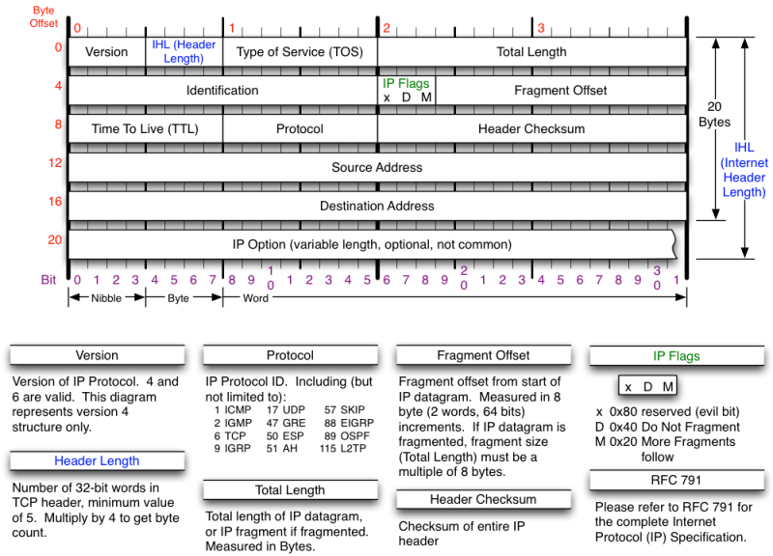
What are packets?
A packet is the unit of data that is routed between an origin and a destination, on the internet or any other packet-switched network.

Slide 5
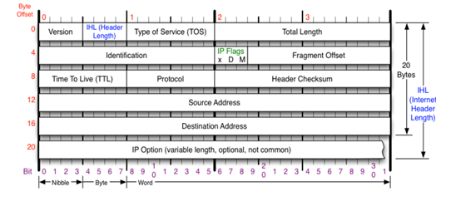
What are packets?
Emphasis on TCP, UDP, DNS & ARP Packets

Slide 6
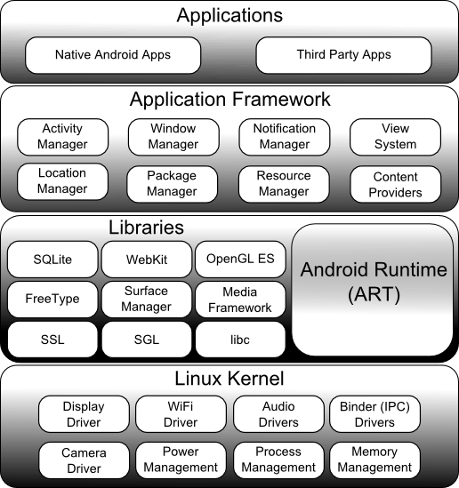
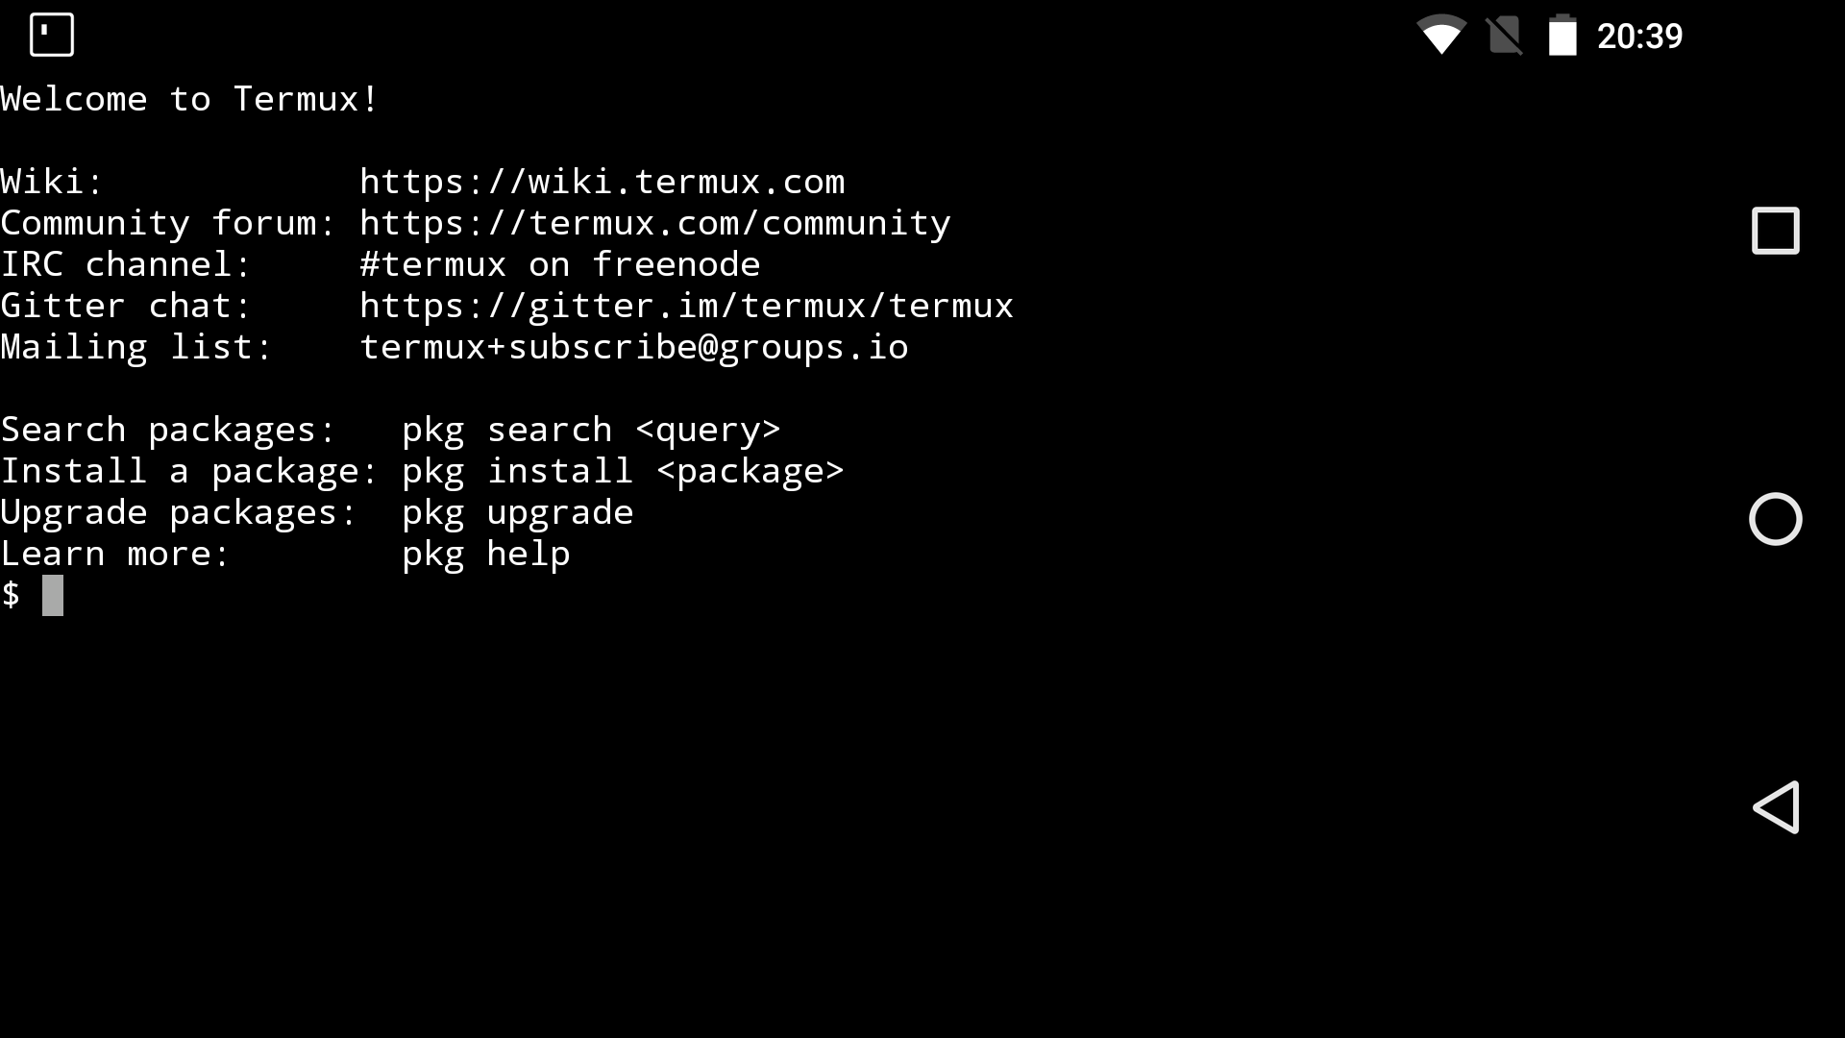
Android v. Linux architecture
Android’s kernel is derived from Linux, not the same but very similar
Android permissions are far different from Linux (configurability wise) as more emphasis is given for ease of use. (Why would normal users want a shell for their Android device?)
Termux is a command line interface application and is used as we test and develop NetSniffer

Slide 7
Android Hardware Requirements
Most PCs have NIC cards that can be set to promiscuous or monitor mode without much hassle.
On Android devices however, it may range from difficult, to impossible. Manufacturers do not support fiddling with hardware, with only enthusiasts working on related projects at their own risk.
NIC cards require drivers to update their firmware to allow monitor / promiscuous mode. On PC it is easy and can be done in a few clicks. On Android, the Linux kernel has to be extracted via binary dump, have the drivers installed in the correct locations, and recompile the entire OS, then the device has to be re-flashed with the new OS.

Slide 8
Workaround for HW limitations - Nexmon
NexMon gives full control over a Wi-Fi Chip for research purposes is limited by firmware, which means it is hard to evolve communication protocols and test schemes in practical environments. Monitor mode as mentioned above allows eavesdropping on all frames on a wireless communication channel. This includes uses such as network packet analyses, security research and testing of new medium access control layer protocols, it is offered by SoftMAC drivers that implement the media access control sublayer management entity (MLME) in the driver rather than in the Wi-Fi Chip. On smartphones, mostly FullMAC (HardMAC) chips are used to reduce power consumption as the tasks do not need to wake up the main processor. Even though it is possible in FullMAC situations, it is generally not implemented in today’s Wi-Fi firmware’s used in smart phones which is one of the limitations that our project is facing, that is why in such situations we are bringing monitor mode to Nexus 5 Smartphones to enhance the interoperability between applications that require monitor mode and the BCM4339 Wi-Fi Chips.

Slide 9
What are binaries? Why use binaries?
Binary executables are compiled with their required libraries and can be executed without any other interpretation or file.
Binaries for NetSniffer have to be compiled with their required libraries for the ARM architecture (for Android).
Instead of binaries, executables can be written into an apk file itself. Libraries such as Libpcap and Jnetpcap can be integrated with the application, however, it is impossible to grant an application root user privileges
Therefore, binaries have to be used, then executed within the application

Slide 10

TCPDump & Libpcap
TCPDump is a free software designed by Van Jacobson, Sally Floyd Vern Paxson and Steven McCanne in 1988. It is built with libpcap library in C to read packets from a network interface card.
wget http://www.tcpdump.org/release/libpcap-1.8.1.tar.gz
tar -xf libpcap-1.8.1.tar.gz
sudo apt-get update
sudo apt-get install flex
sudo apt-get install bison
cd libpcap-1.8.1
./configure –prefix=/usr
make
sudo make install

Slide 11
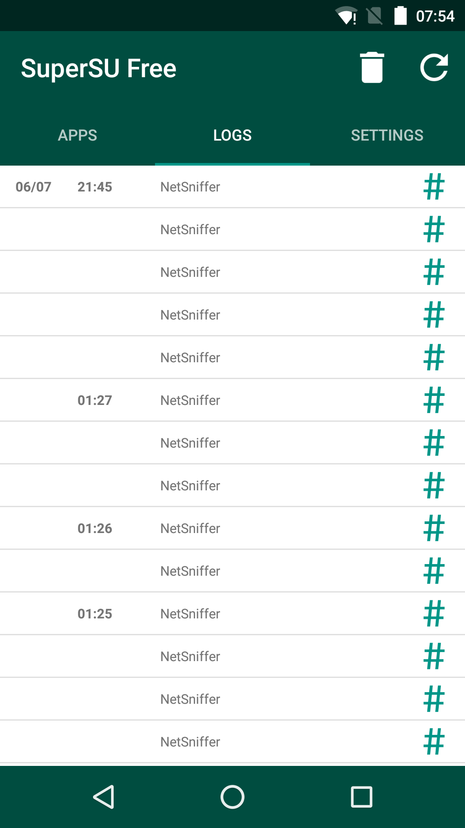
Rooting an Android device
Rooting of an Android device is how a user gets complete access to everything in the OS, which adds the command “su” or superuser to Android
On Android, enthusiasts would find ways to escalate their privileges to superuser, which is NOT supported by their manufacturers and results in voiding of warranty
As such, rooting of devices differ and there is no surefire or standard way to root a device, and attempts to root a device may result in a “bricked” device, breaking the device.
We have attempted multiple attempts to root our chosen device, the Nexus 5 with several solutions, but finally achieved root with “CF-Auto-Root”
Permissions are managed with the external application SuperSU

Slide 12
Difficulties faced
HW has to be compatible (NIC)
Only specific devices can be used
Root privileges
Unable to debug / test on emulator
Unsupported and experimental
Process has to be used, and managed, not much support available

Slide 13
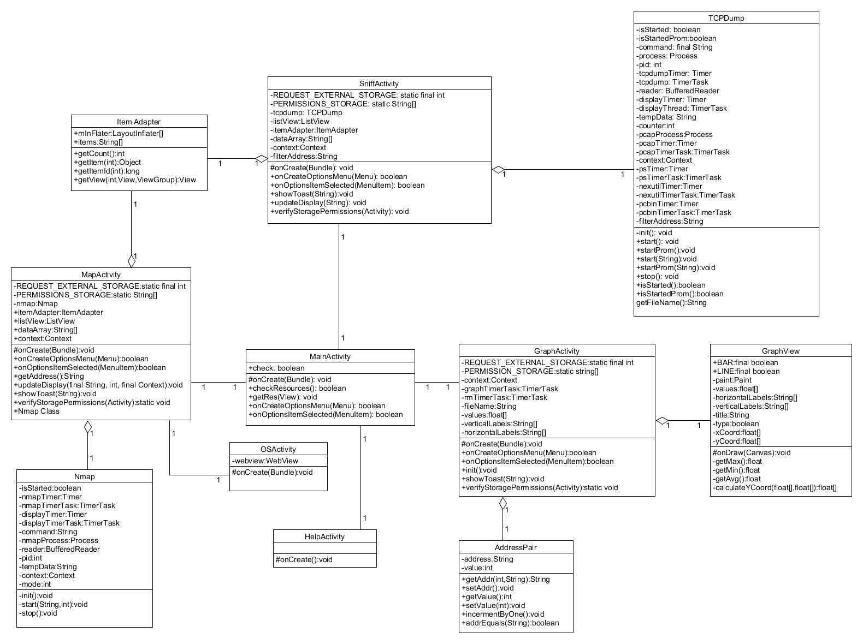
Diagrams - Class

Slide 14
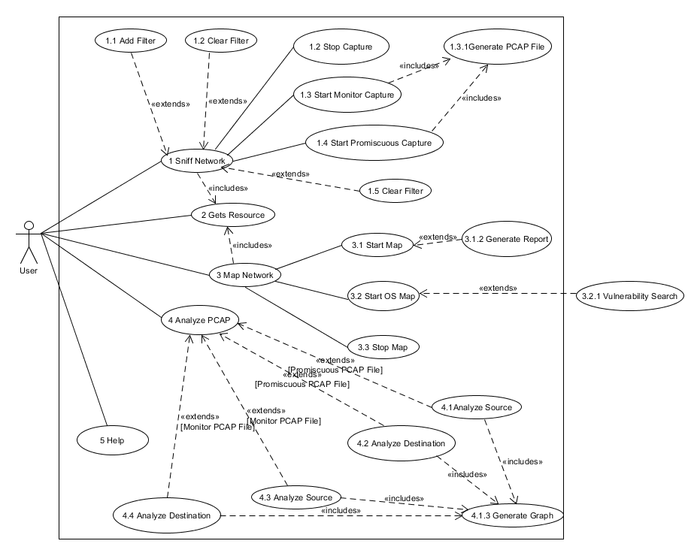
Diagrams - Use Case

Slide 15
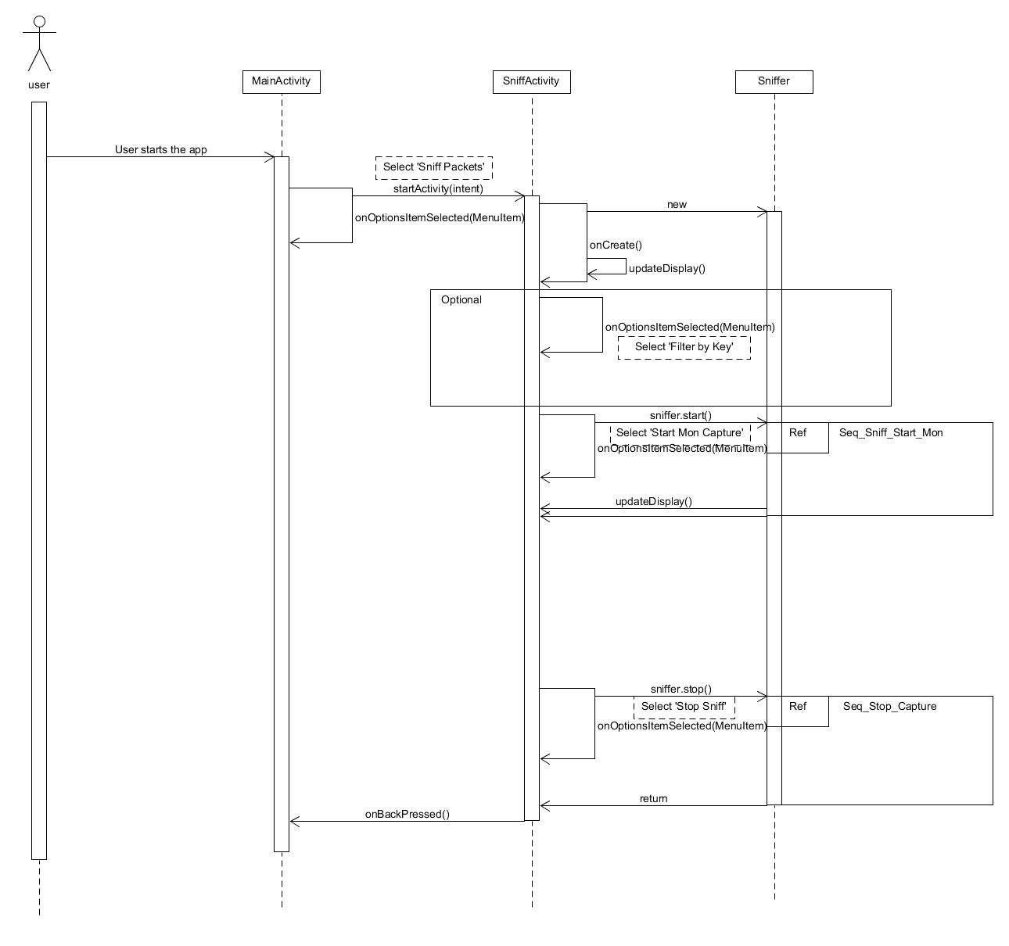
Sequence Start Mon uc 1.3

Slide 16
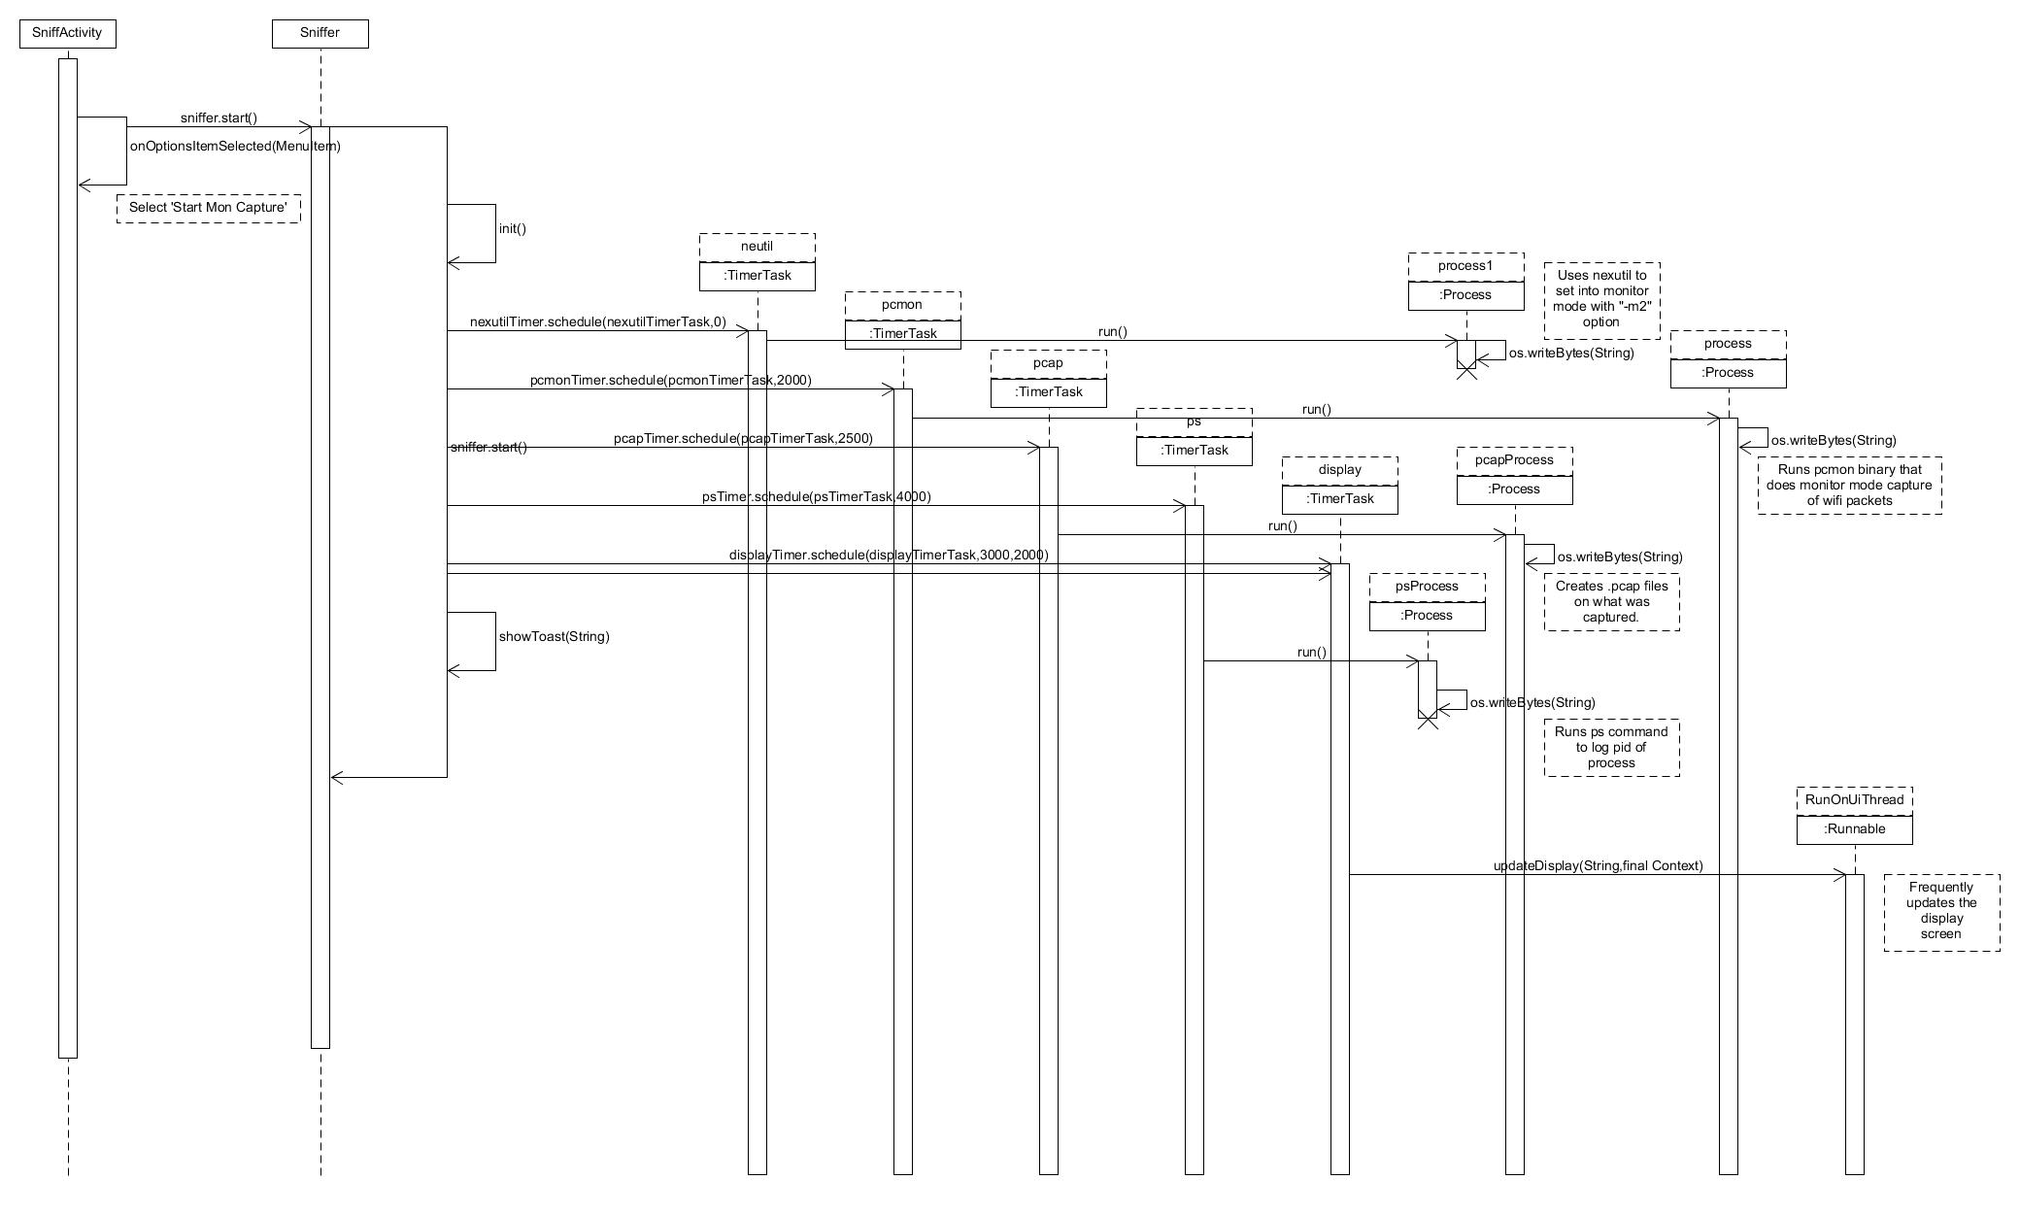
Sequence Sniff Start Mon uc 1.3

Slide 17
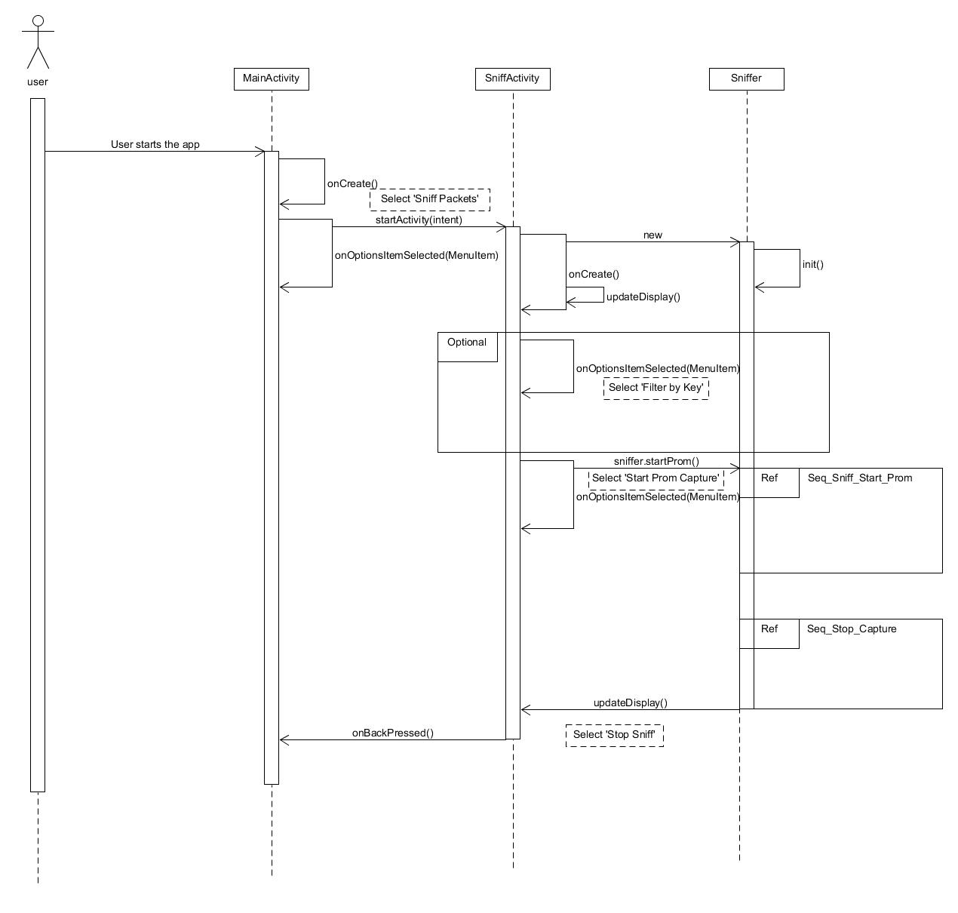
Sequence Start Prom uc 1.4

Slide 18
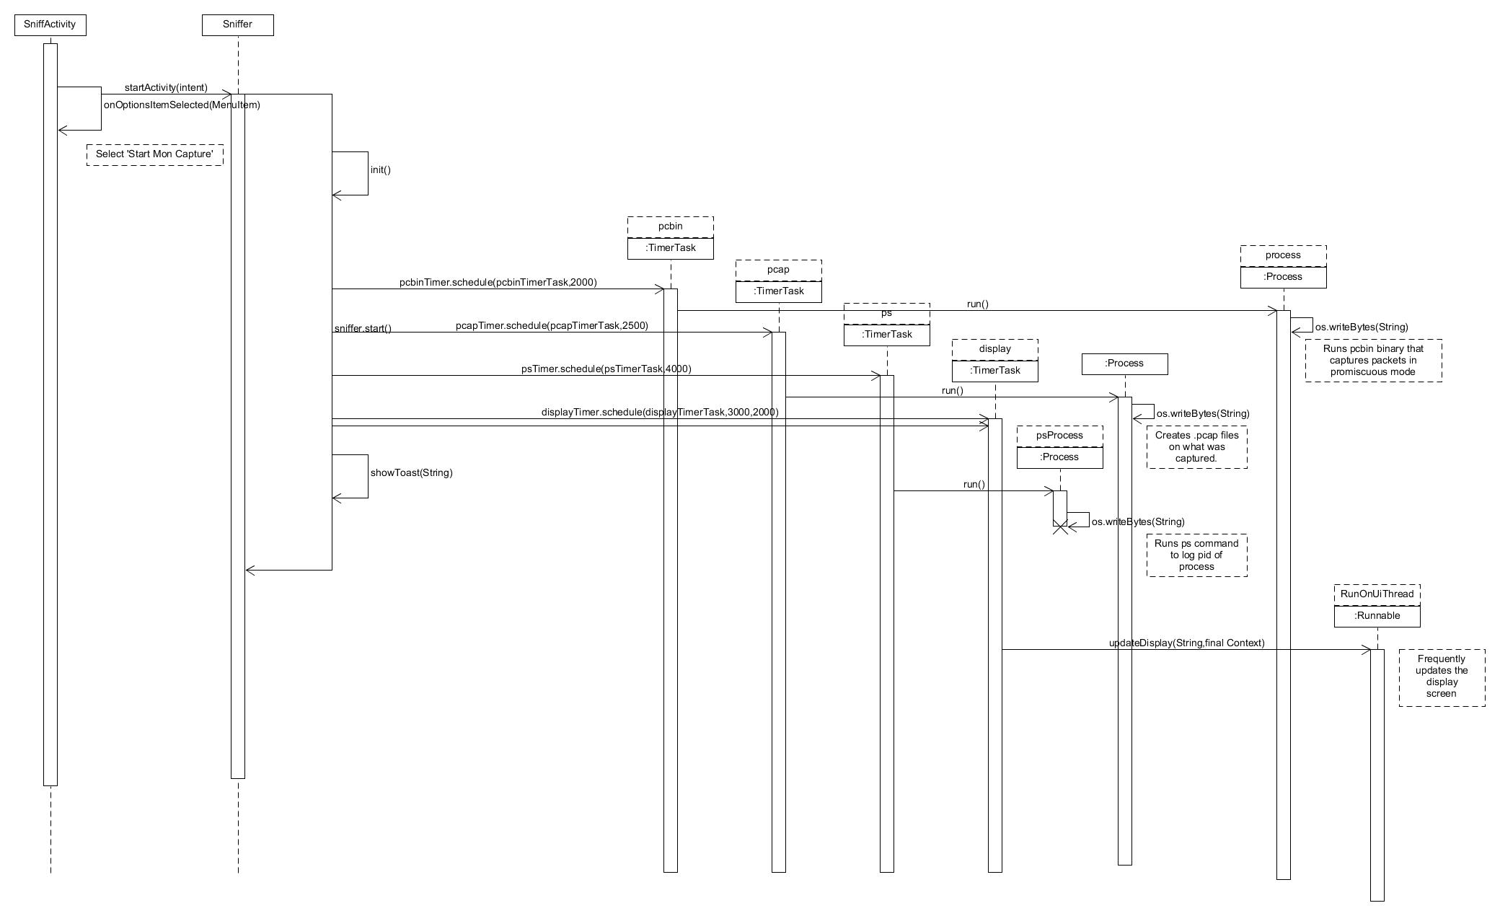
Sequence Sniff Start Prom uc 1.4

Slide 19
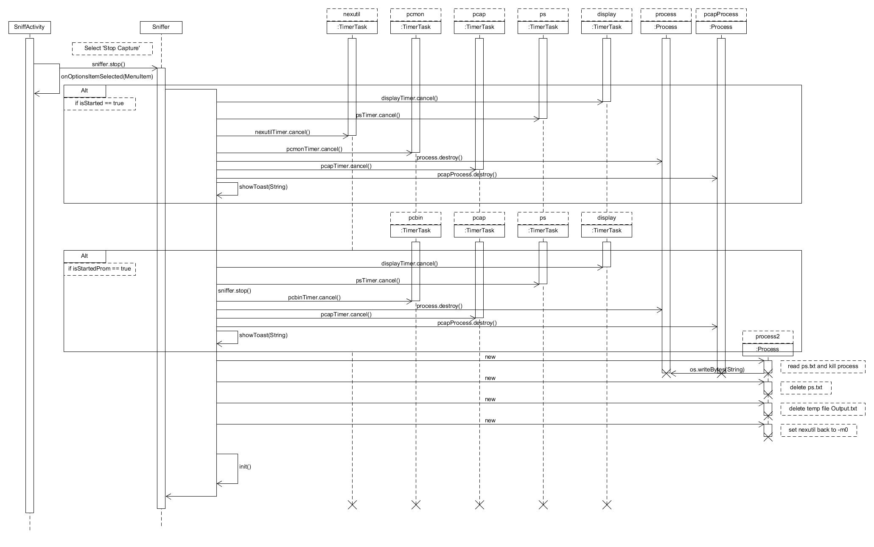
Sequence Stop Capture uc 1.2

Slide 20
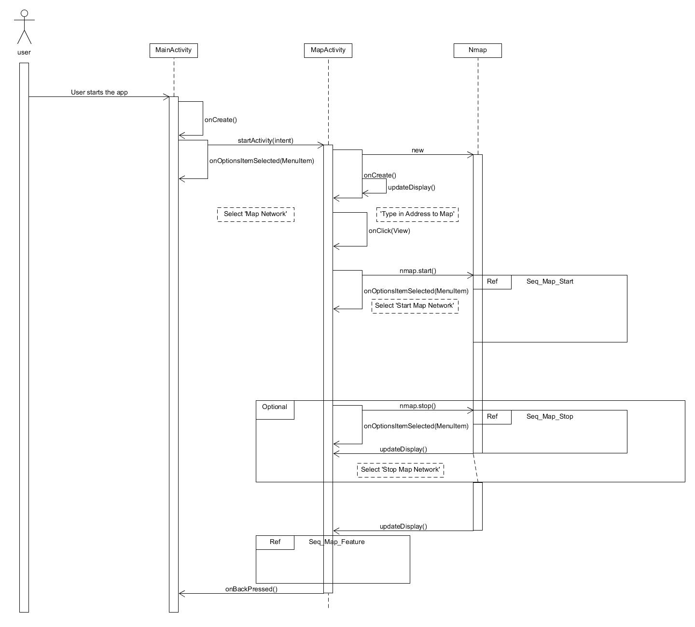
Sequence Start Map Network uc 3.1

Slide 21
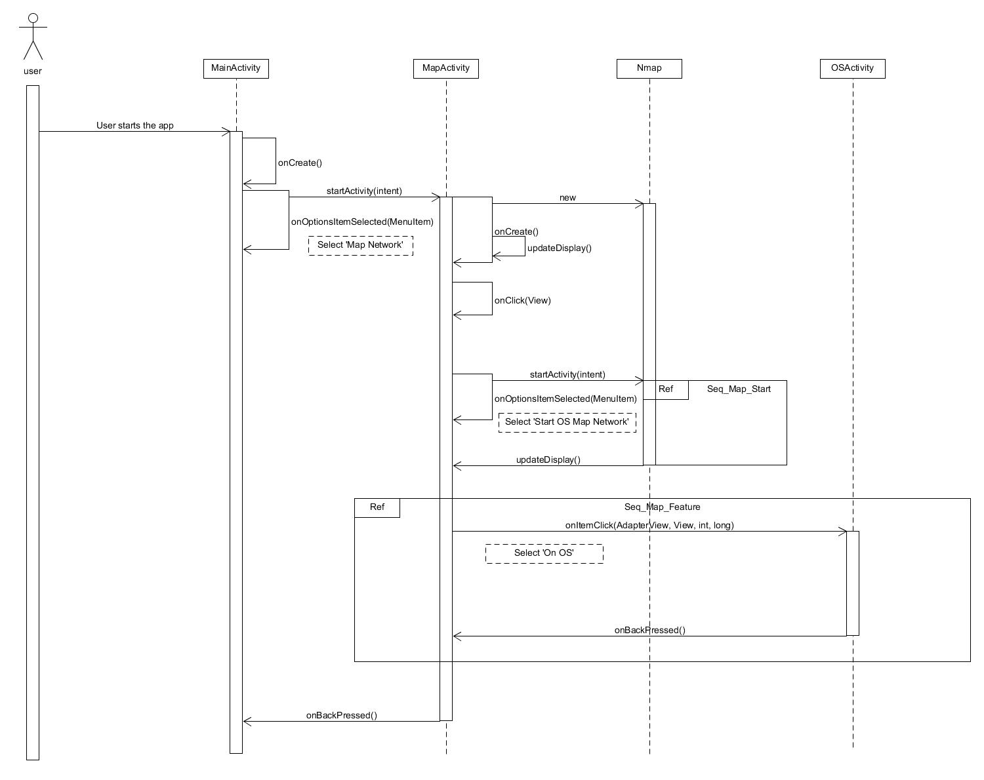
Sequence Start OS Map uc 3.2

Slide 22
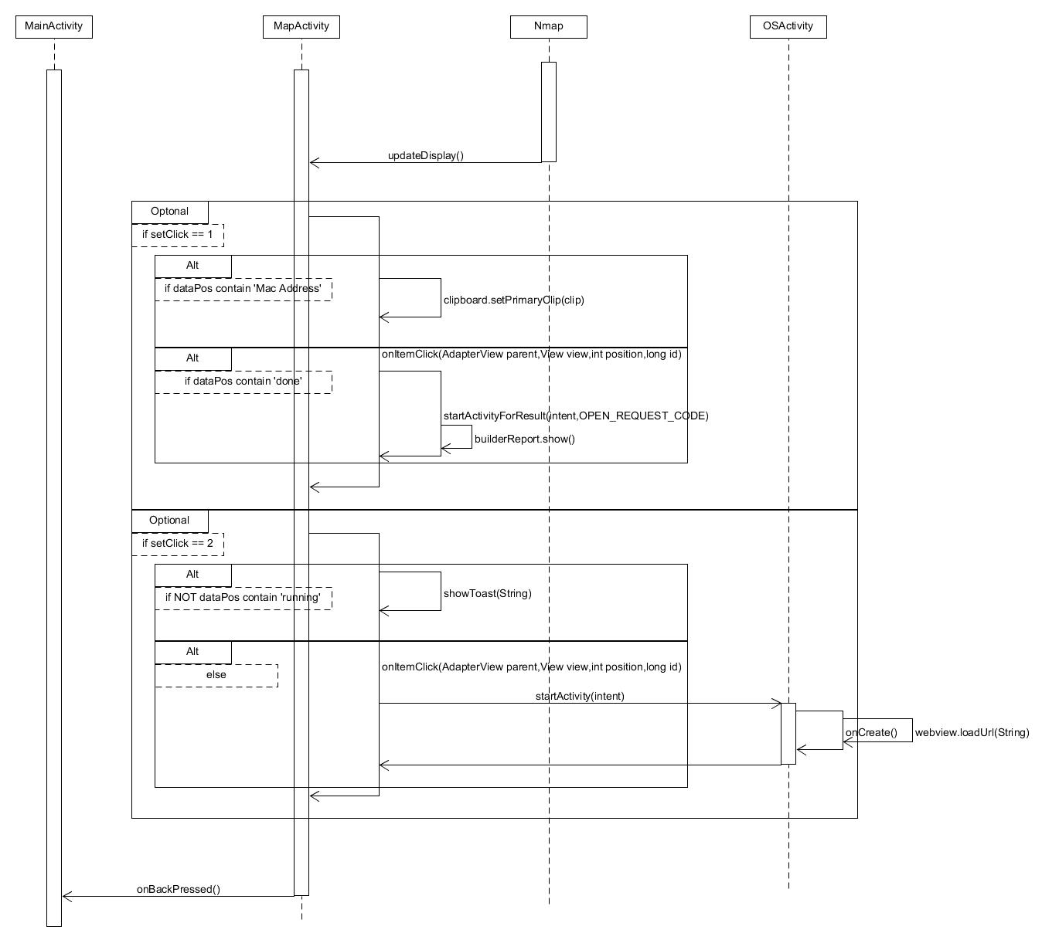
Sequence Map Feature uc 3.1.2/3.2.1

Slide 23
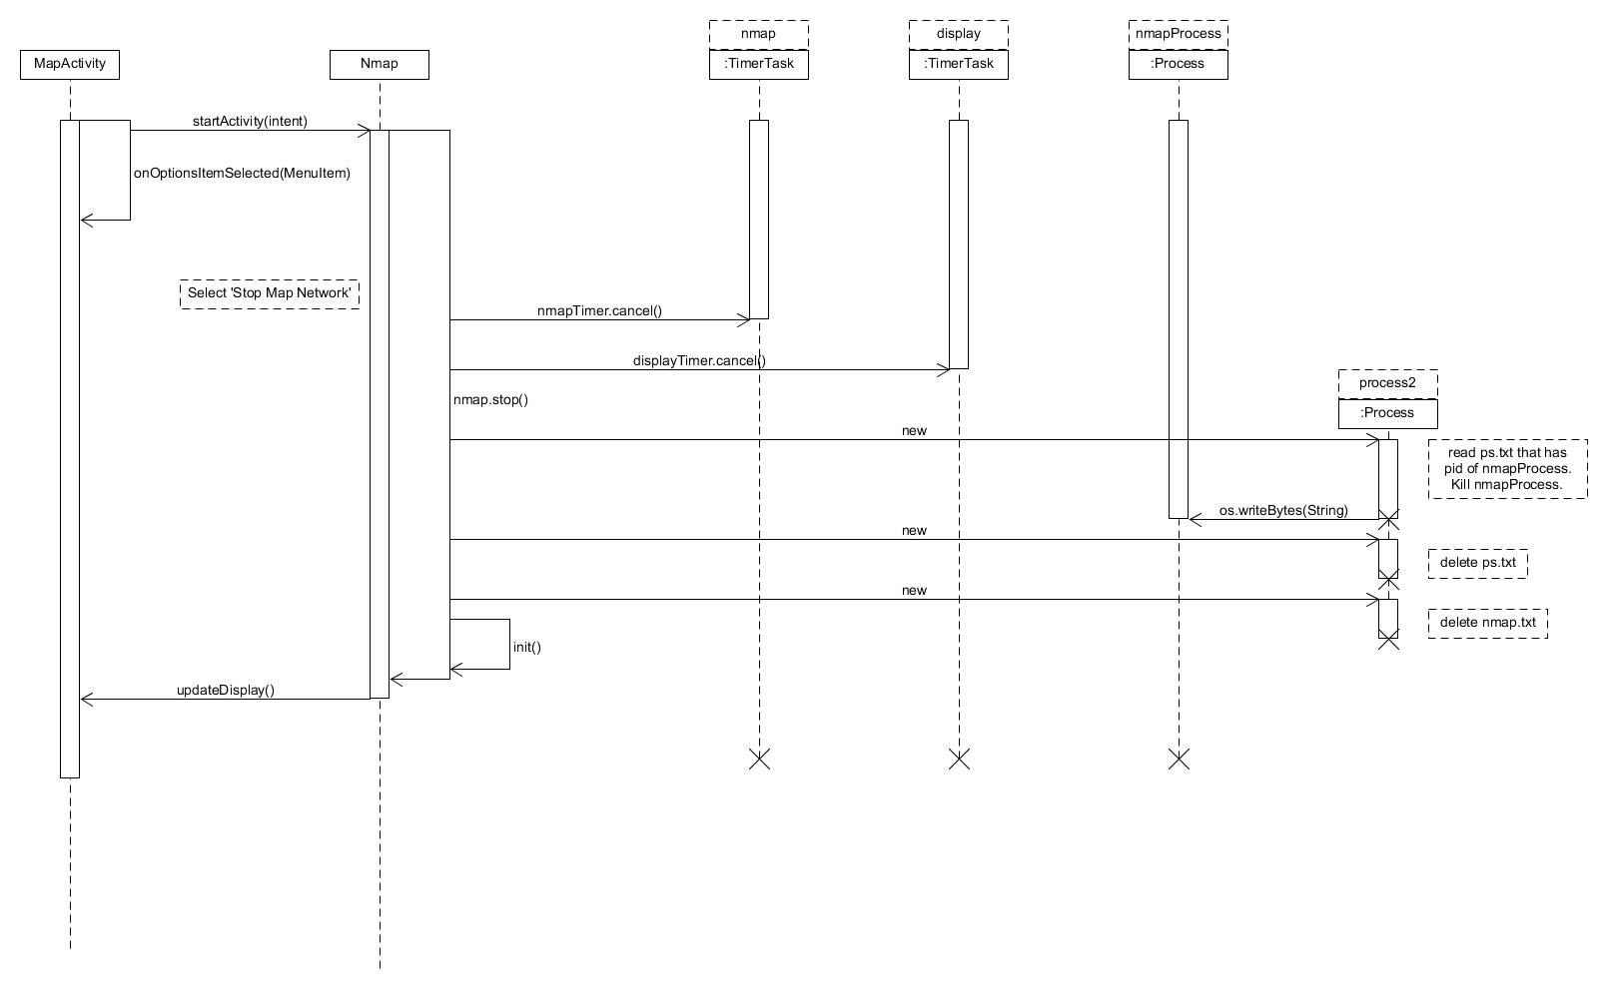
Sequence Map Stop uc 3.3

Slide 24
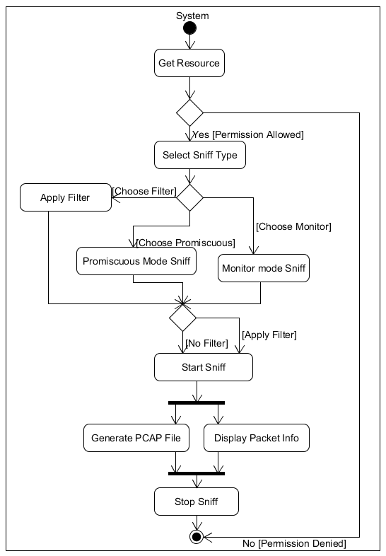
Diagrams - Activity Sniff

Slide 25
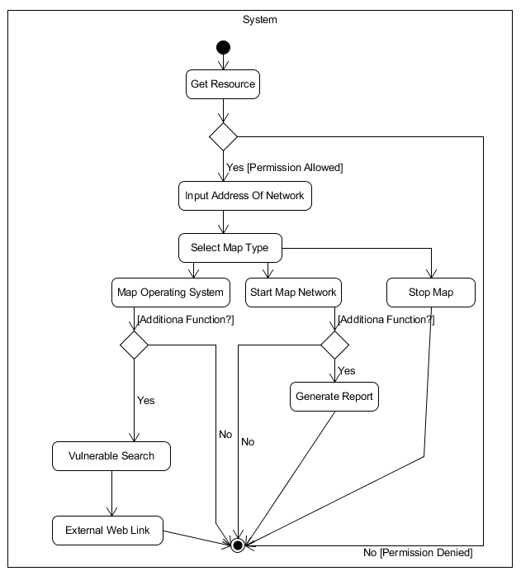
Diagrams - Activity Map

Slide 26
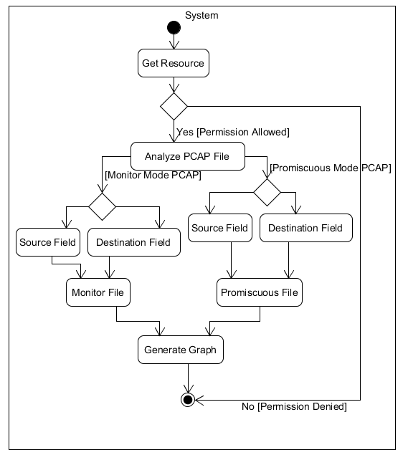
Diagram - Activity Analyze PCAP

Slide 27
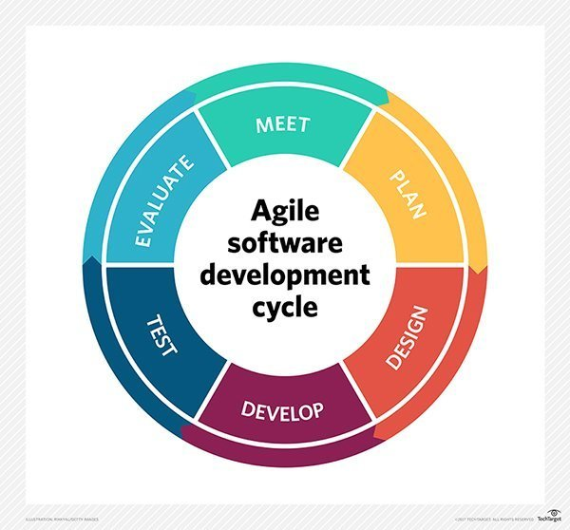
AGILE
We decided AGILE development was the most appropriate.
AGILE software development describes an approach to software development in which the requirements and solutions continually evolve.
AGILE is most appropriate as these variations of software were not prevalent in Android, with mostly experimental support
Our solutions change often with heavy emphasis on prototyping and continual programming to find solutions that satisfy our stipulated functionalities

Slide 28
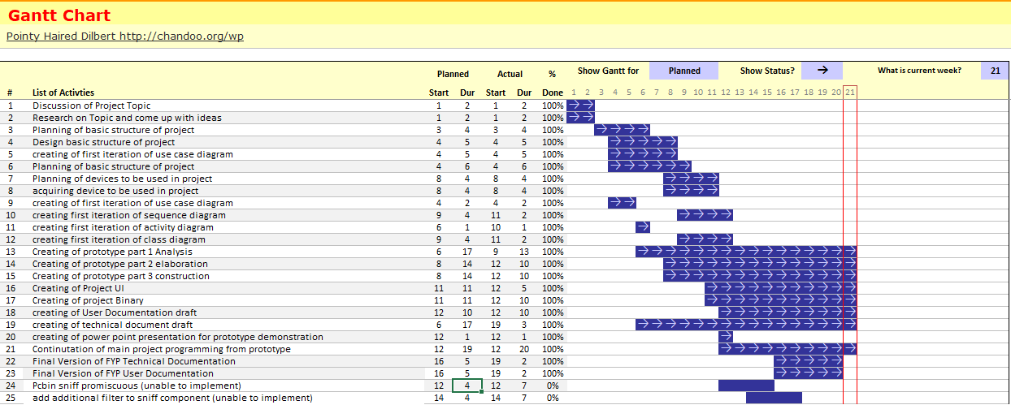
Gantt Chart - Planned

Slide 29
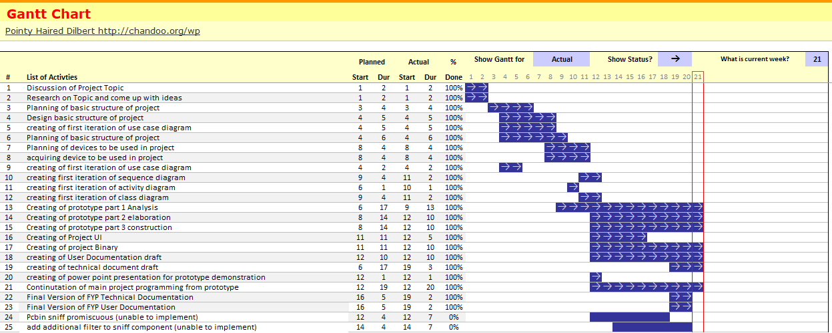
Gantt Chart - Actual

Slide 30
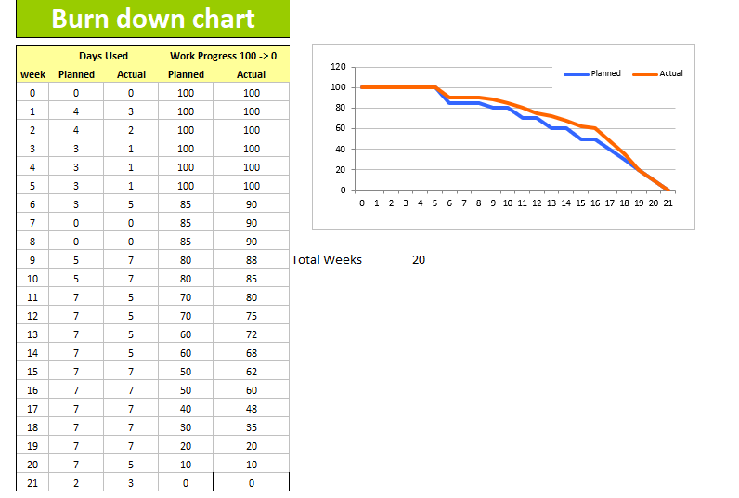
Burndown Chart

Slide 31
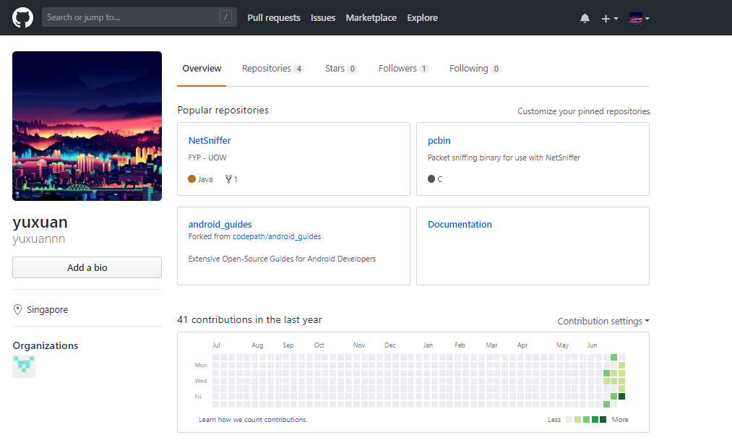
Version Control - Github
The version control we chose was GitHub

Slide 32
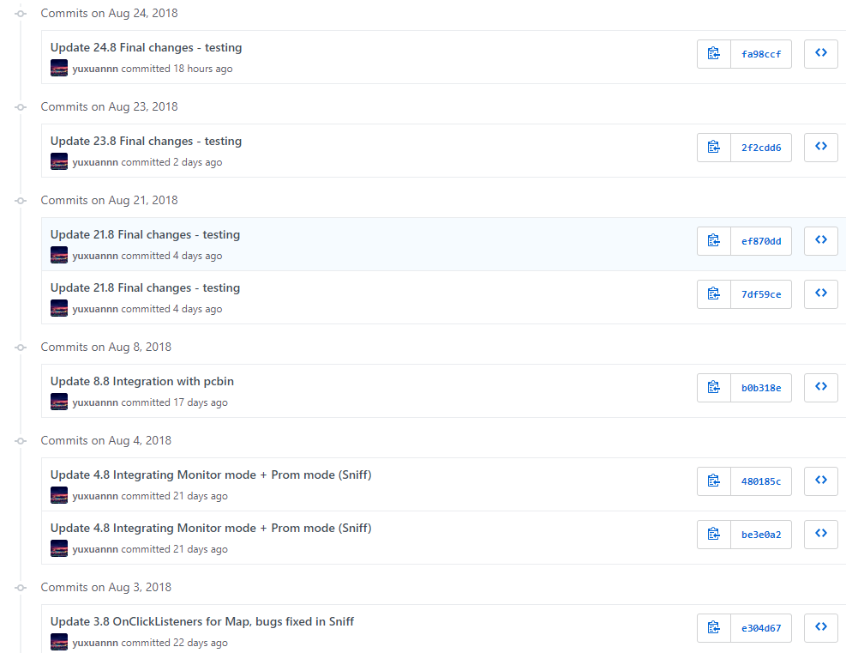
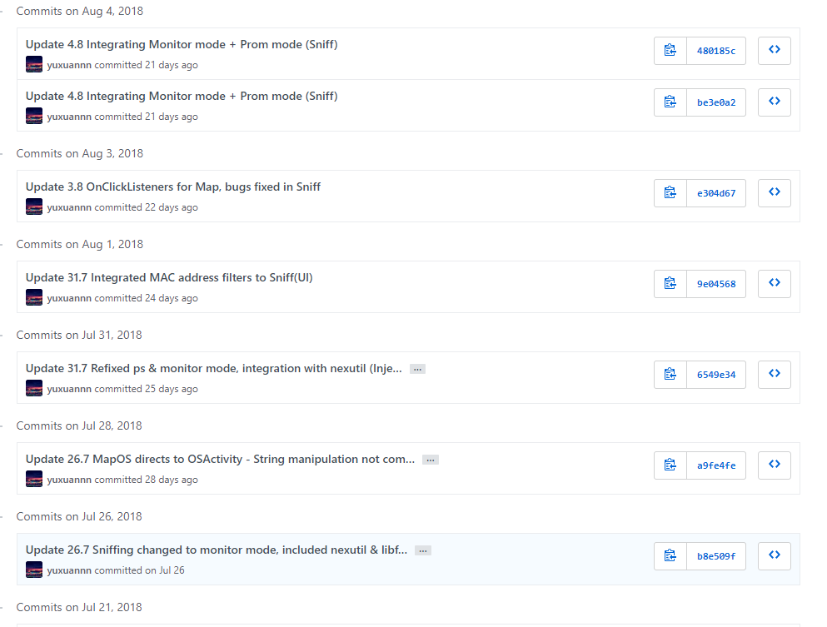
VCS - Github

Slide 33
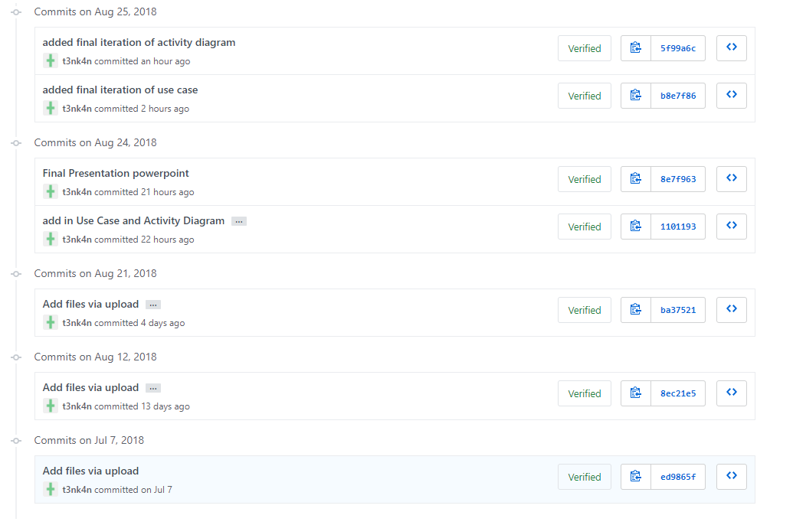
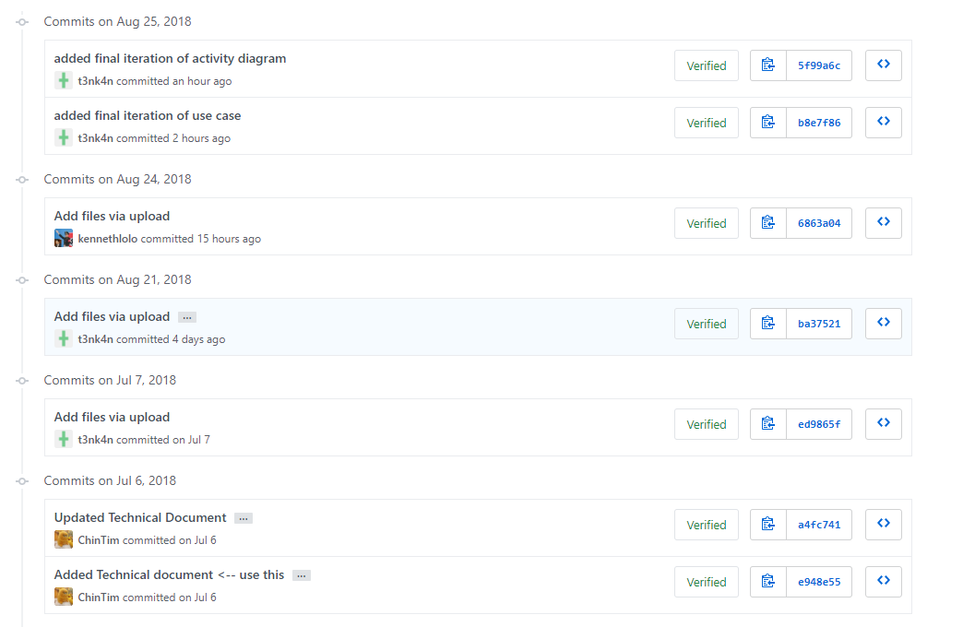
Version Control

Slide 34
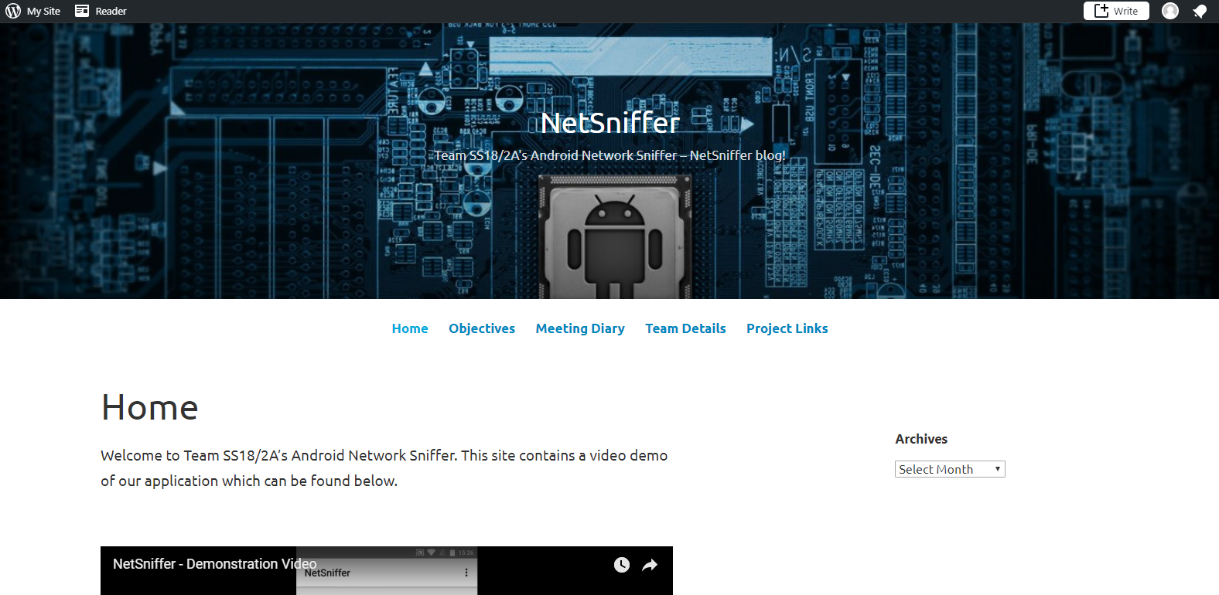
Project Website
https://netsniffer475404635.wordpress.com/

Slide 35
END – Questions?

